Slide 1

C#
Basics
Tutor
Daniel Omajali
Otukpo Tech Academy
Edited Version 1.3

Slide 2
Contents
Introduction
Setting up the environment
C# Syntax
C# Output
C# Comments
Variables
Data types
Type Conversion Methods – Conversion of strings to integers and integers to strings
Receiving inputs from the user
Maths class and methods
Conditional statements
Project – Advanced calculator
Iteration statements
Arrays
Lists
Dictionary
Methods/ Functions
18. Classes and objects
19. Fields and properties
20. Access modifiers
21. Static modifier
22. Object-Orientated concepts – Inheritance, Encapsulation
23. SOLID Programming Principle
24. Handling exceptions in C#
25. Debugging in Visual Studio
26. Git & Github
27. Interfaces
28. Linq
29. Unit Test
30. Working with files
31. Complex classes
32. Sharing data between classes
33. Entity Framework

Slide 3
Introduction
What is C#?
C# is pronounced "C-Sharp".
It is an object-oriented programming language created by Microsoft that runs on the .NET Framework.
C# is used for:
Mobile applications
Desktop applications
Web applications
Web services
Web sites
Games
VR
Database applications
And much, much more!

Slide 4
Setting up the environment
Download and install Visua Studio Community edition from the link below:
https://visualstudio.microsoft.com/downloads/

Slide 5
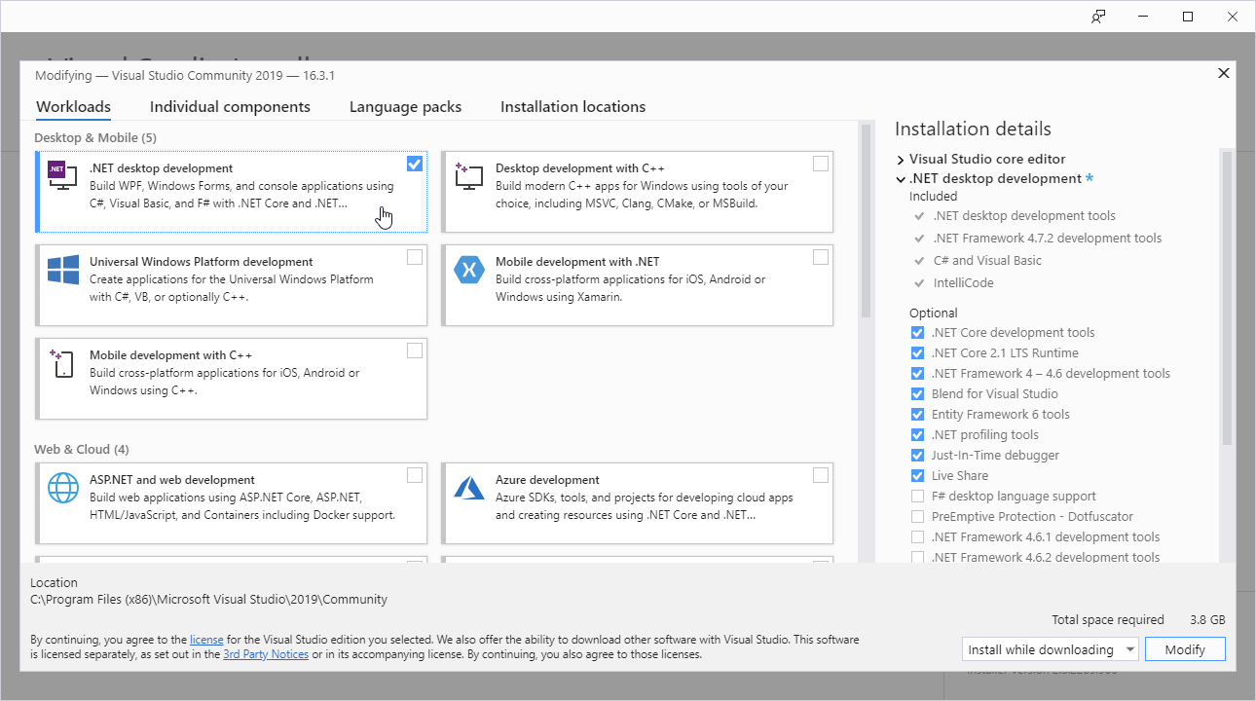
Setting up the environment
C# Install
Once the Visual Studio Installer is downloaded and installed, select the ‘.NET desktop development’ and ‘ASP.NET and web development’ and click on the Modify/Install button:

Slide 6
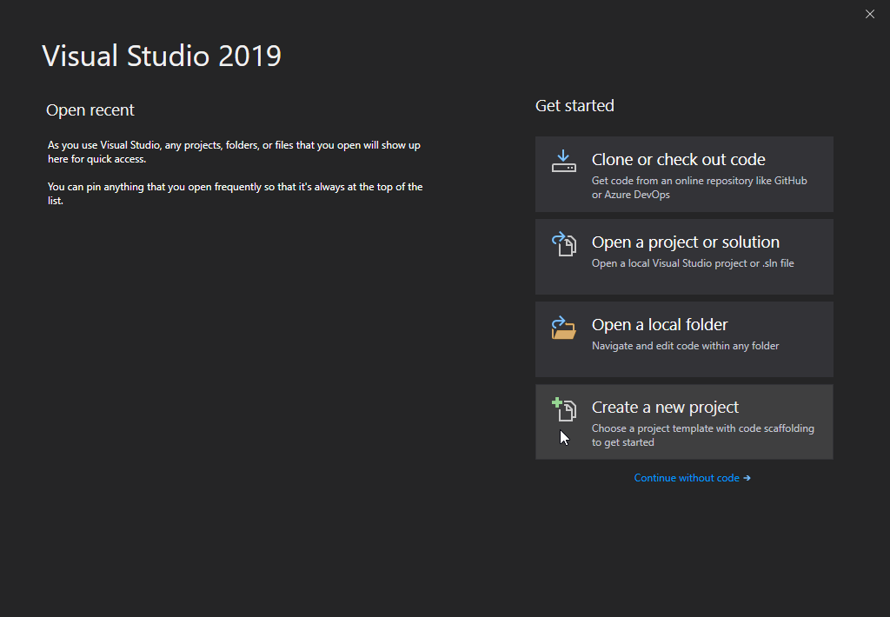
Setting up the environment
C# project create
After the installation is complete, click on the Launch button to get started with Visual Studio.
On the start window, choose Create a new project:

Slide 7
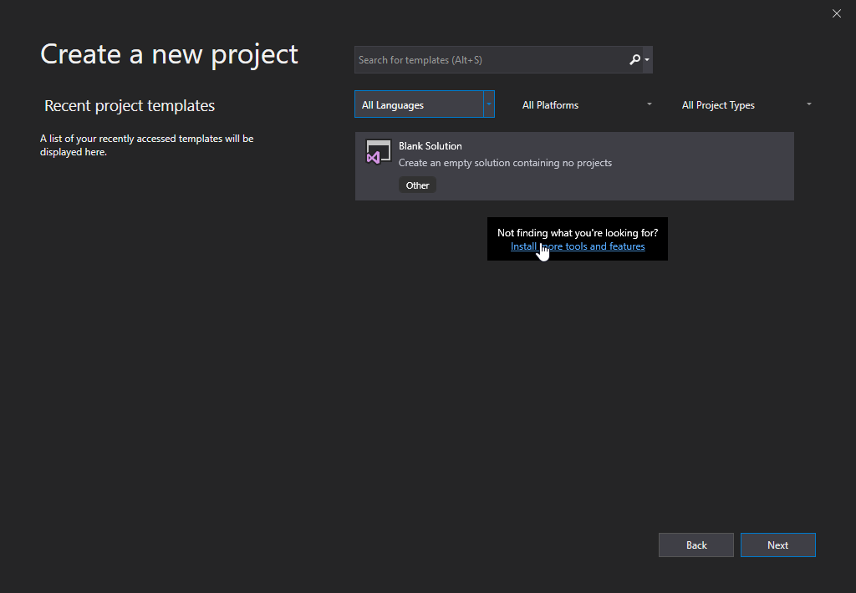
Setting up the environment
C# project create
Then click on the "Install more tools and features" button if “Console App” template does not appear among list of templates

Slide 8
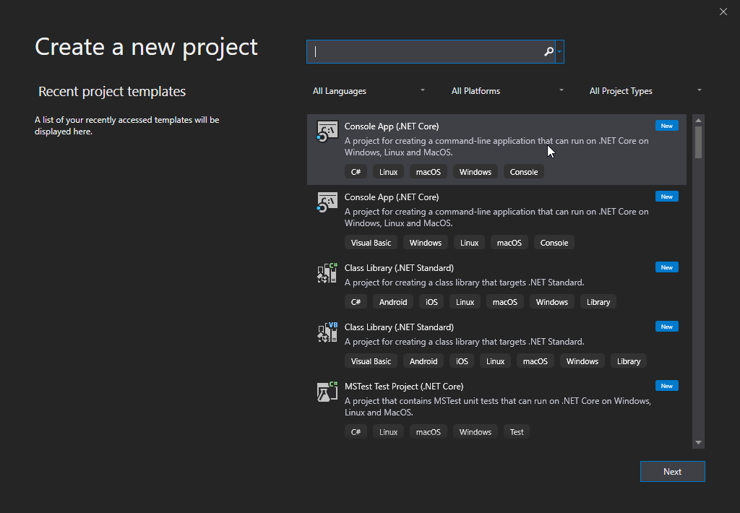
Setting up the environment
C# project create
Choose "Console App (.NET Core)" from the list and click on the Next button:

Slide 9
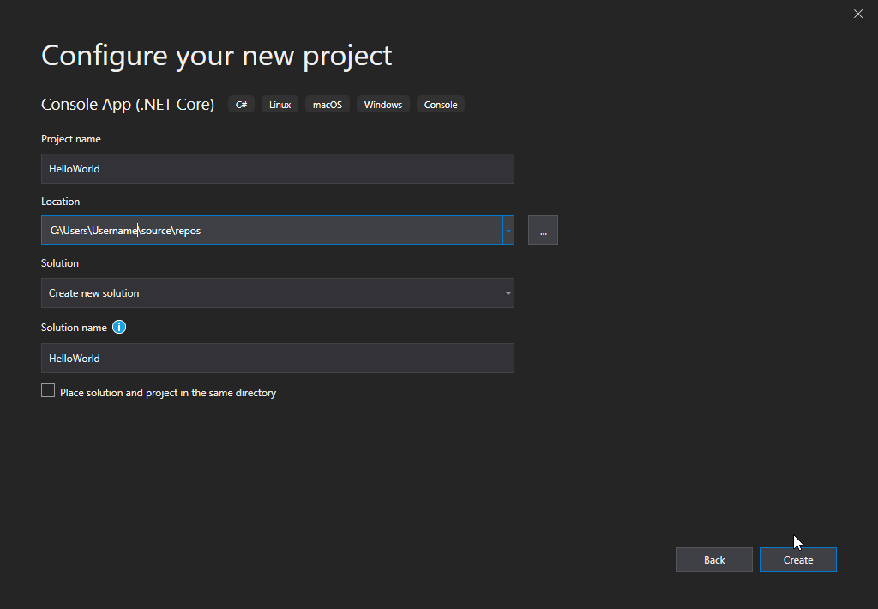
Setting up the environment
C# project create
Enter a name for your project, and click on the Create button:

Slide 10
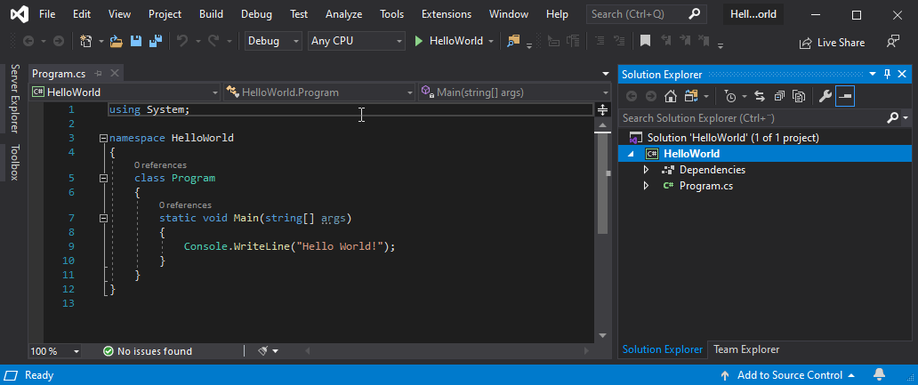
Setting up the environment
C# project create
Visual Studio will automatically generate some code for your project:

Slide 11
C# Syntax
In the previous slide, we created a C# file called Program.cs, and we used the following code to print "Hello World" to the screen:
Console.WriteLine("Hello World!");
Console is a class of the System namespace, which has a WriteLine() method that is used to output/print text. In our example it will output "Hello World!".
Note: Every C# statement ends with a semicolon (;)
Note: C# is case-sensitive: "MyClass" and "myclass" has different meaning
Note: Console.ReadLine(); code is added to keep the console opened when a code is run;

Slide 12
C# Output
To output values or print text in C#, you can use the WriteLine() method or the Write() method:
Console.WriteLine("Hello World!");
You can also output numbers, and perform mathematical calculations:
Console.WriteLine(3 + 3);

Slide 13
C# Comments
Comments can be used to explain C# code, and to make it more readable. It can also be used to prevent execution when testing alternative code.
Single-line Comments:
Single-line comments start with two forward slashes (//).
Any text between // and the end of the line is ignored by C# (will not be executed).
This example uses a single-line comment before a line of code:
// This is a comment
Console.WriteLine("Hello World!");
Console.WriteLine("Hello World!"); // This is a comment

Slide 14
C# Comments
C# Multi-line Comments
Multi-line comments start with /* and ends with */.
Any text between /* and */ will be ignored by C#.
This example uses a multi-line comment (a comment block) to explain the code:
/* The code below will print the words Hello World
to the screen, and it is amazing */
Console.WriteLine("Hello World!");

Slide 15
Variables
Variables are containers for storing data values.
In C#, there are different types of variables (defined with different keywords), for example:
int - stores integers (whole numbers), without decimals, such as 123 or -123
double - stores floating point numbers, with decimals, such as 19.99 or -19.99
char - stores single characters, such as 'a' or 'B'. Char values are surrounded by single quotes
string - stores text, such as "Hello World". String values are surrounded by double quotes
bool - stores values with two states: true or false

Slide 16
Variables
Declearing (Creating) variables
To create a variable, you must specify the type and assign it a value:
Syntax:
type variableName = value;
Where type is a C# type (such as int or string), and variableName is the name of the variable (such as x or name). The equal sign is used to assign values to the variable.
string name = "John";
Console.WriteLine(name);
int myNum = 15;
Console.WriteLine(myNum);

Slide 17
Variables
Declear now, assign later
You can also declare a variable without assigning the value, and assign the value later:
int myNum;
myNum = 15;
Console.WriteLine(myNum);
Overwriting an existing variable value
Note that if you assign a new value to an existing variable, it will overwrite the previous value:
int myNum = 15;
myNum = 20; // myNum is now 20
Console.WriteLine(myNum); // Outputs 20

Slide 18
Class Work
Create a variable to store your name, your height, your phone number and true or false if you are a male. Use the “declare now assign now” and also the declare now assign later” to create your variables

Slide 19
Variables
Preventing overwriting an existing variable value through the use of ‘const’ keyword
However, you can add the const keyword if you don't want others (or yourself) to overwrite existing values (this will declare the variable as "constant", which means unchangeable and read-only):
const int myNum = 15;
myNum = 20; // error
The const keyword is useful when you want a variable to always store the same value, so that others (or yourself) won't mess up your code.
Note: You cannot declare a constant variable without assigning the value. If you do, an error will occur: A const field requires a value to be provided.

Slide 20
Data types
As explained in the variables chapter, a variable in C# must be a specified data type:
int myNum = 5; // Integer (whole number)
double myDoubleNum = 5.99D; // Floating point number
decimal myDecimalNum = 6.2M; // Floating point number
char myLetter = 'D'; // Character.. Uses single quotation
bool myBool = true; // Boolean
string myText = "Hello"; // String.. Uses double quotation

Slide 21
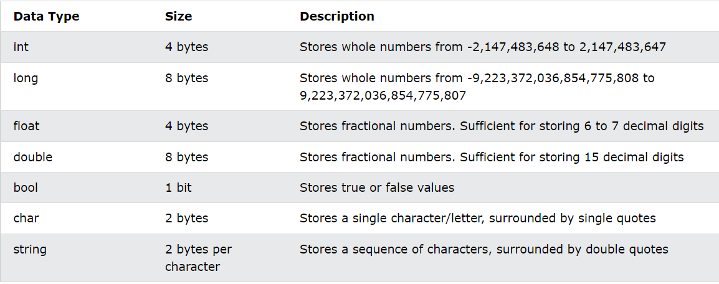
Data types
A data type specifies the size and type of variable values. It is important to use the correct data type for the corresponding variable; to avoid errors, to save time and memory, but it will also make your code more maintainable and readable. The most common data types are:

Slide 22
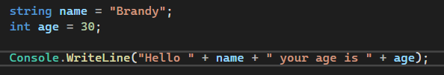
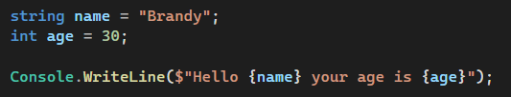
Data types
String Concatenation in C#
String Interpolation in C#

Slide 23
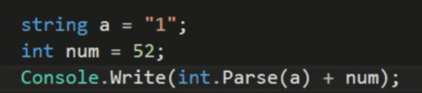
Type conversion methods
Convert string to integer

Slide 24
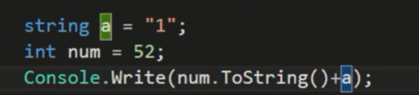
Type conversion methods
Convert integer to string

Slide 25
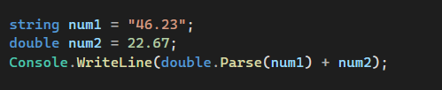
Type conversion methods
Convert string to double

Slide 26
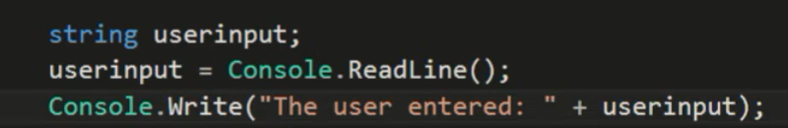
Receiving inputs from the user
Note: Userinput is always a string data type.

Slide 27
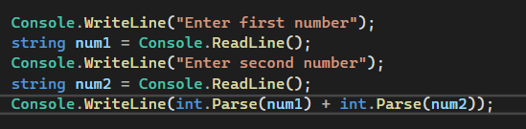
Receiving inputs from the user
Simple addition calculator project

Slide 28
Math class and methods
The C# Math class has many methods that allows you to perform mathematical tasks on numbers.
Math.Max(x,y)
The Math.Max(x,y) method can be used to find the highest value of x and y:
Math.Max(5, 10);
Math.Min(x,y)
The Math.Min(x,y) method can be used to find the lowest value of of x and y:
Math.Min(5, 10);
Math.Sqrt(x)
The Math.Sqrt(x) method returns the square root of x:
Math.Sqrt(64);

Slide 29
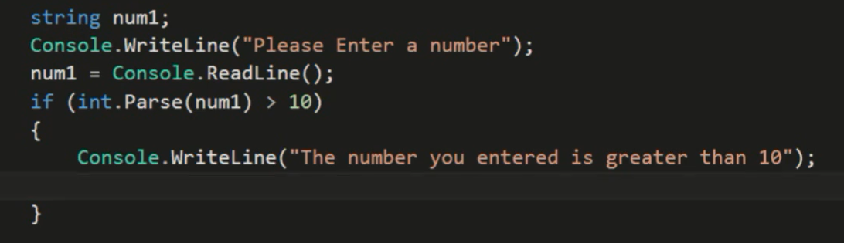
Conditional statements – if statement

Slide 30
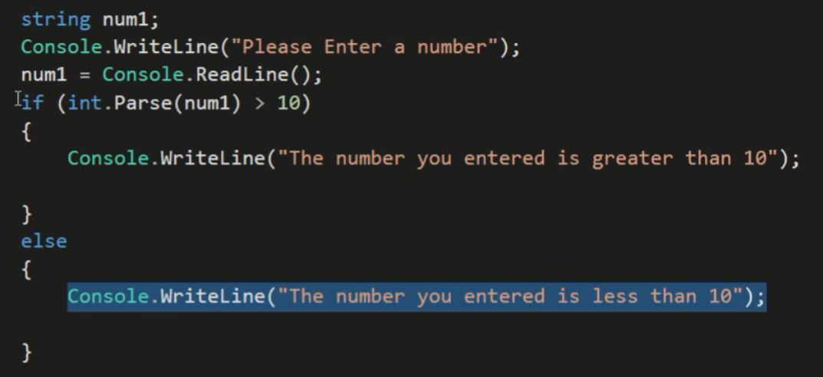
Conditional statements – else statement

Slide 31
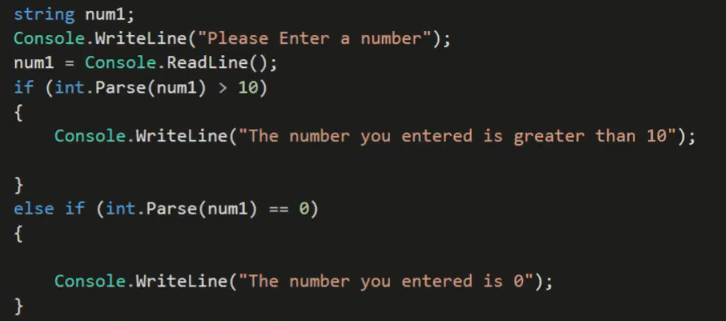
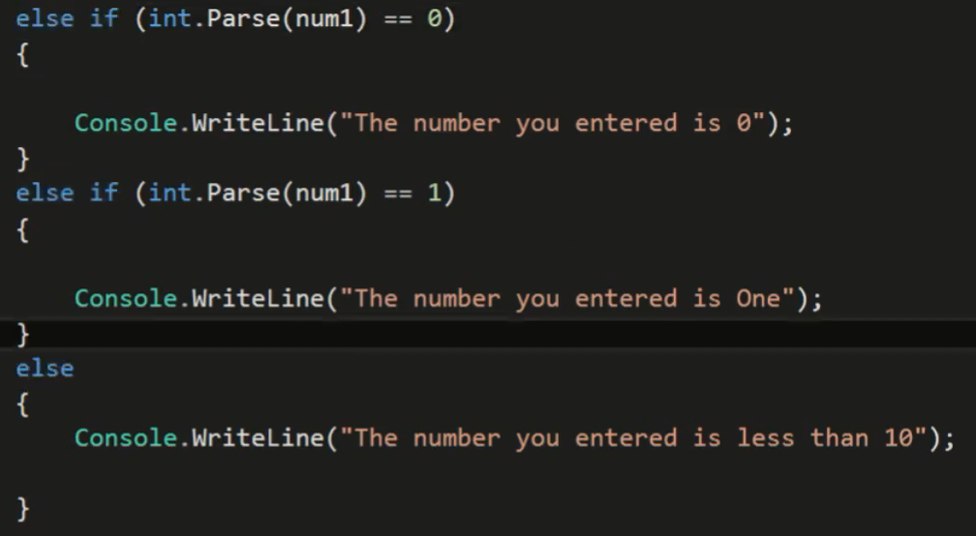
Conditional statements – if else statement

Slide 32

Project : Advanced calculator
Features:
Operators (+, -, *, /, %)
Square root
Validation

Slide 33
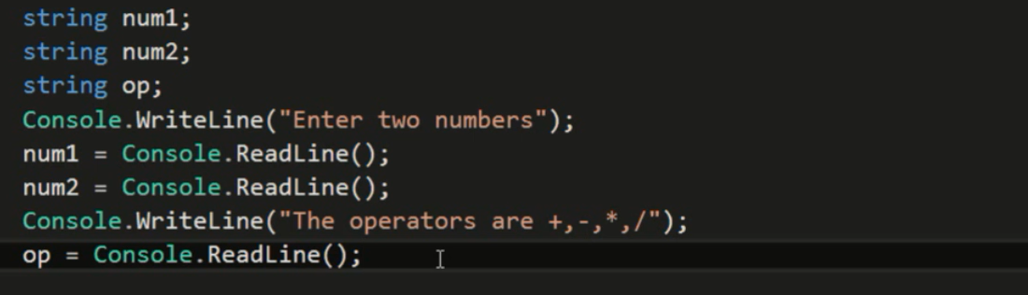
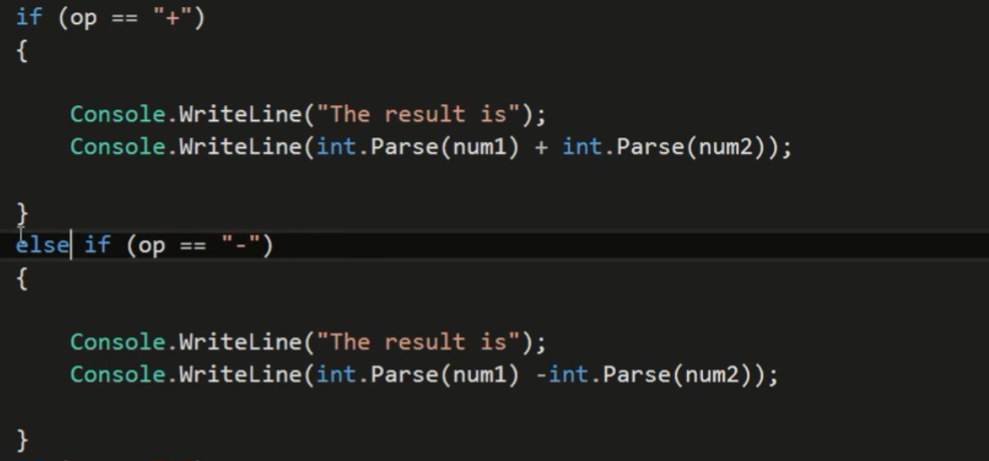
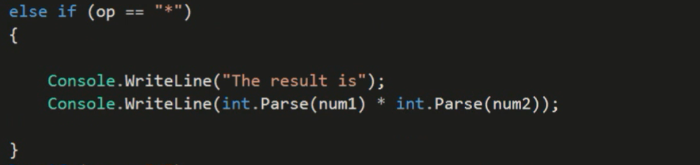
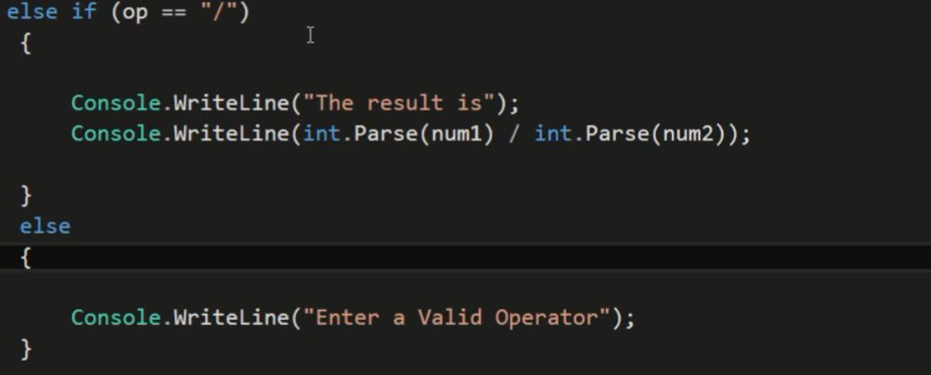
Advanced calculator

Slide 34
Iteration statements
Iteration statements also known as looping statements are statements that helps in performing a specific task again and again as long as the condition within the iteration statement is satisfied.
Types of Iteration statements
FOR LOOP
WHILE LOOP
DO WHILE LOOP

Slide 35
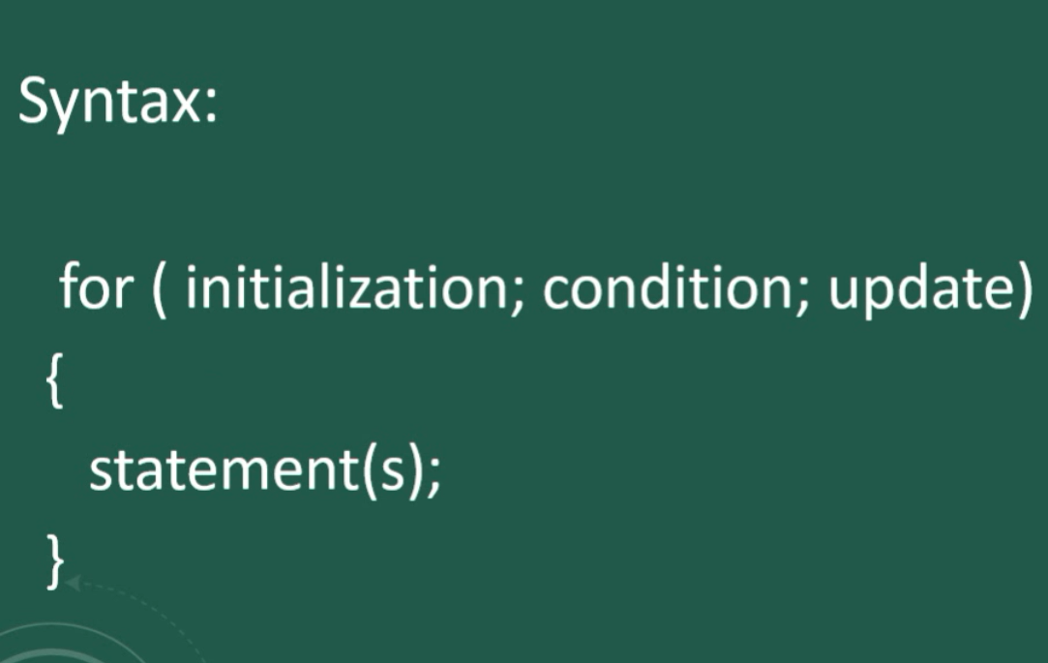
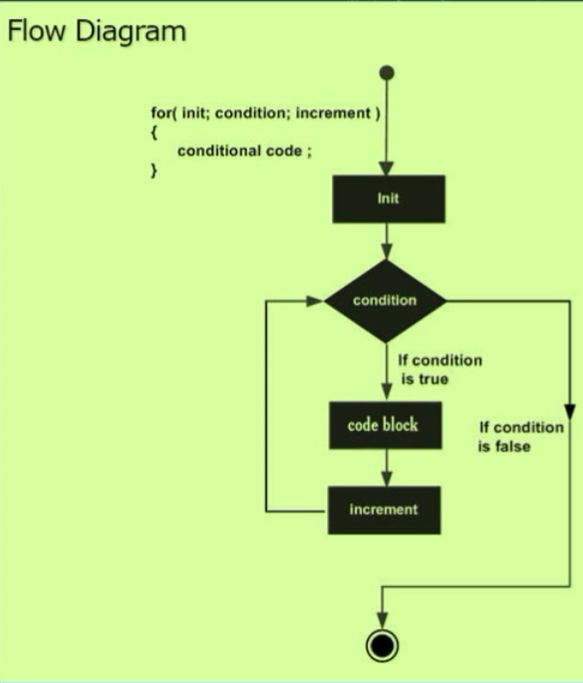
Iteration statements
FOR loop

Slide 36
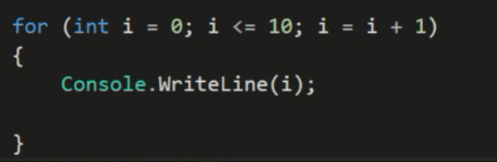
Iteration statements
FOR loop example

Slide 37
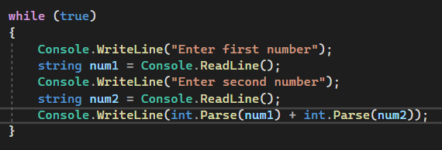
Iteration statements
WHILE loop example

Slide 38
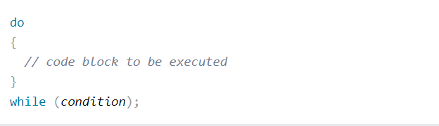
Iteration statements
DO WHILE loop
The do/while loop is a variant of the while loop. This loop will execute the code block once, before checking if the condition is true, then it will repeat the loop as long as the condition is true.

Slide 39
Arrays
Arrays are used to store multiple values in a single variable, instead of declaring separate variables for each value.
Note: Counting of array elements starts from 0.
To declare an array, define the variable type with square brackets:
Array of strings:
string[] cars;
We have now declared a variable that holds an array of strings.
To insert values to it, we can use an array literal - place the values in a comma-separated list, inside curly braces:
string[] cars = {"Volvo", "BMW", "Ford", "Mazda"};

Slide 40
Arrays
Array of integers:
To create an array of integers, you could write:
int[] myNum = {10, 20, 30, 40};
Access the Elements of an Array:
You access an array element by referring to the index number.
This statement accesses the value of the first element in cars:
string[] cars = {"Volvo", "BMW", "Ford", "Mazda"};
Console.WriteLine(cars[0]); // Outputs Volvo

Slide 41
Arrays
Change an Array Element:
To change the value of a specific element, refer to the index number:
string[] cars = {"Volvo", "BMW", "Ford", "Mazda"};
cars[0] = "Opel";
Console.WriteLine(cars[0]); // Now outputs Opel instead of Volvo

Slide 42
Arrays
The foreach Loop:
There is also a foreach loop, which is used exclusively to loop through elements in an array:
string[] cars = {"Volvo", "BMW", "Ford", "Mazda"};
foreach (string i in cars)
{
Console.WriteLine(i);
}

Slide 43
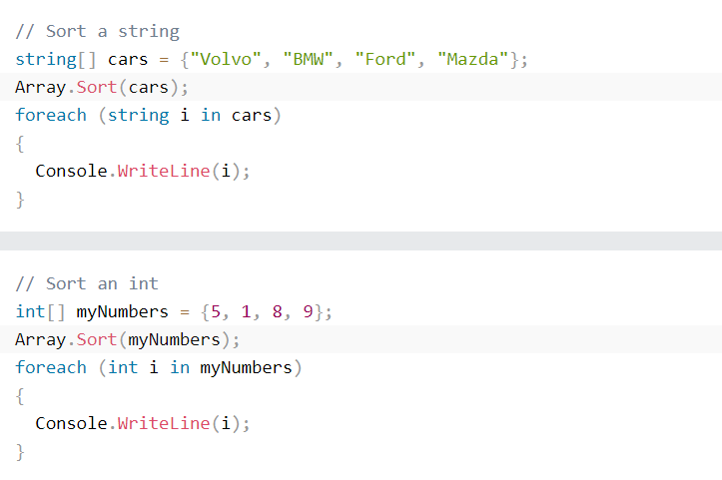
Arrays
Sort Arrays
There are many array methods available, for example Sort(), which sorts an array alphabetically or in an ascending order:

Slide 44
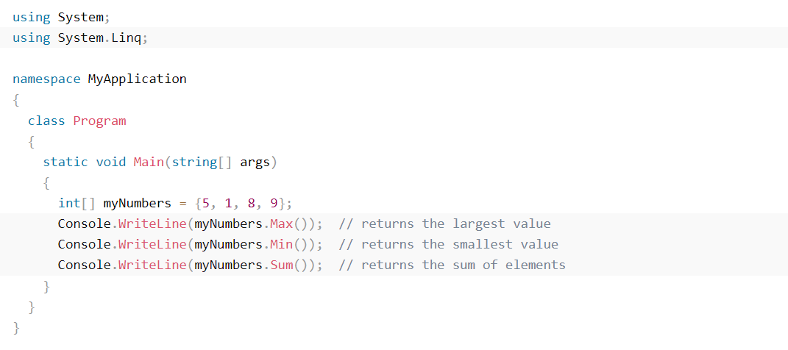
Arrays
System.Linq Namespace
Other useful array methods, such as Min, Max, and Sum, can be found in the System.Linq namespace:

Slide 45
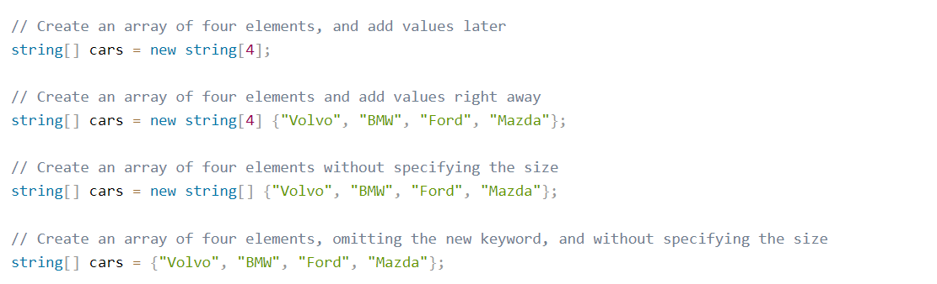
Arrays
Other Ways to Create an Array
In C#, there are different ways to create an array:

Slide 46
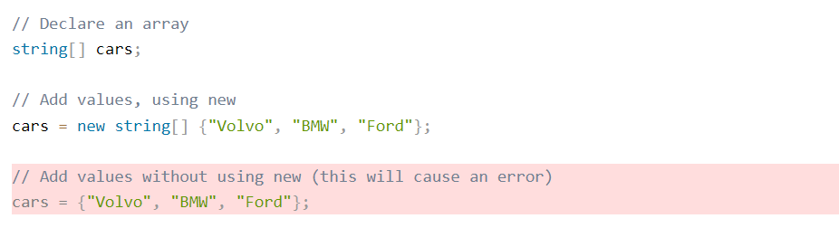
Arrays
It is up to you which option you choose. In our tutorial, we will often use the last option in previous slide, as it is faster and easier to read.
However, you should note that if you declare an array and initialize it later, you have to use the new keyword:

Slide 47
Lists
A list is a data structure that represents a list of objects that can be accessed by index. A list is similar to array but a list can dynamically increase or decrease in size unlike array.
Creating/declaring a new list:
List<string> foods = new List<string>();
Add items to our list:
foods.Add("Rice");
foods.Add("Beans");
foods.Add("Yam");
foods.Add("Indomie");
Display the first item in food list:
Console.WriteLine(foods[0]);
Display all items in food list using foreach loop:
foreach(var food in foods)
{
Console.WriteLine(food); ;
}

Slide 48
Lists
Remove item from list:
foods.Remove("Rice"); //This removes Rice from the list of foods
Insert item into list at specified index location:
foods.Insert(0, "Spaghetti"); //This inserts Spaghetti to the beginning of the list of foods
Get current size of list:
Console.WriteLine(foods.Count);
Check if item exists in list:
Console.WriteLine(foods.Contains("Beans")); //We get a true because Beansexists in list of foods
Sort list alphabetically:
foods.Sort();
Convert list into an array:
string[] foodsArray = foods.ToArray();

Slide 49
Dictionary
Dictionary represents a collection of keys and values and values in a dictionary can be identified/accessed by their respective keys.
Creating/declaring a new dictionary:
Dictionary<int, string> customers = new Dictionary<int, string>();
Add items to our dictionary:
customers.Add(1, "Moses");
customers.Add(2, "James");
customers.Add(3, "Peace");
customers.Add(4, "Faith");
Display customer with the key 3:
Console.WriteLine(customers[3]);
Note: You cannot use same key twice. For example, we cannot use the key of 1,2,3, or 4 again because we have assigned them to a value already.

Slide 50
Dictionary
Displaying all the customers in the dictionary:
foreach(var customer in customers)
{
Console.WriteLine(customer); //Display both key and value
Console.WriteLine(customer.Key); //Display only key
Console.WriteLine(customer.Value); //Display only value
}

Slide 51
Dictionary
Changing/Updating the value of an element based on its key:
customers[1] = "Brandy";
Adding a new element to the dictionary by means of assigning
customers[5] = "Mabel";
Check if a particular key exists in the dictionary
Console.WriteLine(customers.ContainsKey(3)); //Returns true
Removing an element from the dictionary based on its key
customers.Remove(1);

Slide 52
Class Work
Create a dictionary with your hobbies.
Add at least 5 hobbies and loop through them.

Slide 53
Project : Phone Book App
Create a Phone Book application using a dictionary and conditional statement to store name and phone number.
Your application should be able to add, view , update and delete contact.
Name should be the key while the phone number should be the value.

Slide 54
Methods/Functions
A method is a block of code which only runs when it is called.
You can pass data, known as parameters into a method.
Methods are used to perform certain actions, and they are also known as functions.
Why use methods? To reuse code: define the code once, and use it many times.
Parts of a function
Function definition: This is the code inside the function; it deals with what the function is suppose to do
Function call: A function can only work when it is called. This is the process of calling the function so as to activate it

Slide 55
Methods/Functions
Create a Method
A method is defined with the name of the method, followed by parentheses (). C# provides some pre-defined methods, which you already are familiar with, such as Main(), but you can also create your own methods to perform certain actions:
Create a method inside the Program class but outside the Main method:
static void MyMethod()
{
Console.WriteLine(“How are you");
}

Slide 56
Methods/Functions
Code explained
MyMethod() is the name of the method
static means that the method belongs to the Program class and not an object of the Program class. You will learn more about objects and how to access methods through objects later in this tutorial
void means that this method does not have a return value. You will learn more about return values later

Slide 57
Methods/Functions
Call a Method
To call (execute) a method, write the method's name followed by two parentheses () and a semicolon ;
In the previous example, MyMethod() is used to print a text (How are you), when it is called:
Inside the Main() method, call the MyMethod() method:
MyMethod();
A method can be called multiple times
MyMethod();
MyMethod();
MyMethod();

Slide 58
Methods/Functions
Method Parameters
Information can be passed to methods as parameter. Parameters act as variables inside the method.
They are specified after the method name, inside the parentheses. You can add as many parameters as you want, just separate them with a comma.
Example (Defining a method that adds two numbers)
static void AddMethod(int num1, int num2)
{
Console.WriteLine(num1 + num2);
}

Slide 59
Methods/Functions
Calling the method in the Main() and parsing two numbers to be added:
AddMethod(4, 3); //Outputs 7
Return values
The void keyword, used in the examples above, indicates that the method should not return a value. If you want the method to return a value, you can use a primitive data type (such as int or double) instead of void, and use the return keyword inside the method:
Define the method
static int MyMethod(int x)
{
return 5 + x;
}
Call the method
Console.WriteLine(MyMethod(3)); // Outputs 8 (5 + 3)

Slide 60
Project : Quiz App
Create a Quiz App

Slide 61
Classes and objects
C# OOP
OOP stands for Object-Oriented Programming.
Procedural programming is about writing procedures or methods that perform operations on the data, while object-oriented programming is about creating objects that contain both data and methods.
Object-oriented programming has several advantages over procedural programming:
OOP is faster and easier to execute
OOP provides a clear structure for the programs
OOP helps to keep the C# code DRY "Don't Repeat Yourself", and makes the code easier to maintain, modify and debug
OOP makes it possible to create full reusable applications with less code and shorter development time
Tip: The "Don't Repeat Yourself" (DRY) principle is about reducing the repetition of code. You should extract out the codes that are common for the application, and place them at a single place and reuse them instead of repeating it.

Slide 62
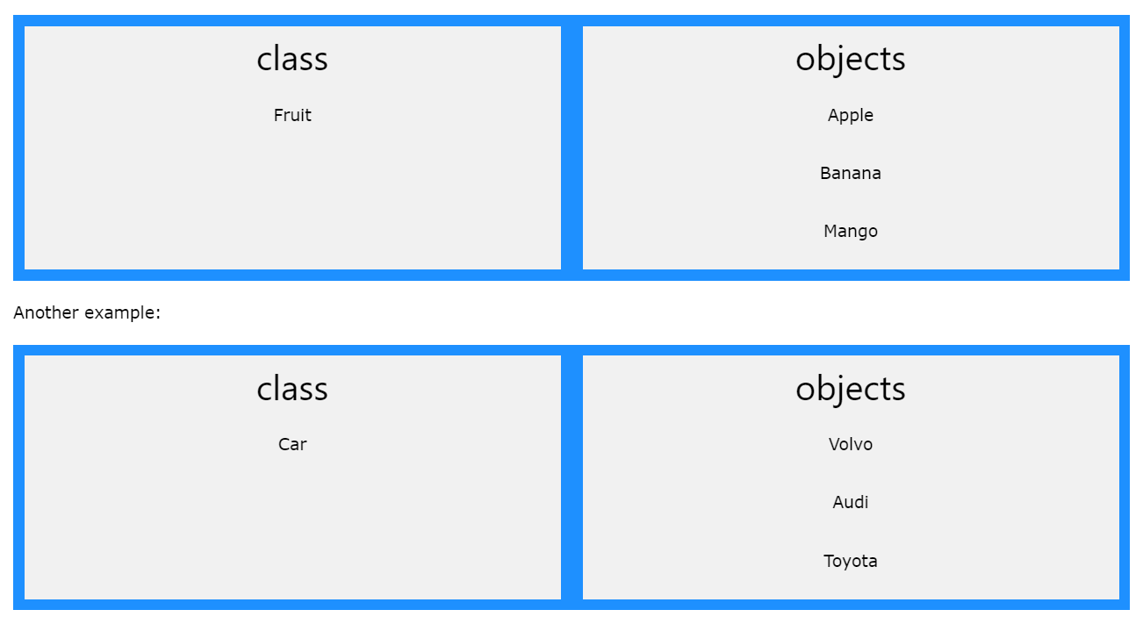
Classes and objects
What are Classes and Objects?
Classes and objects are the two main aspects of object-oriented programming.
Look at the following illustration to see the difference between class and objects:

Slide 63
Classes and objects
So, a class is a template for objects, and an object is an instance of a class.
When the individual objects are created, they inherit all the variables and methods from the class.
You will learn much more about classes and objects in the next slide.

Slide 64
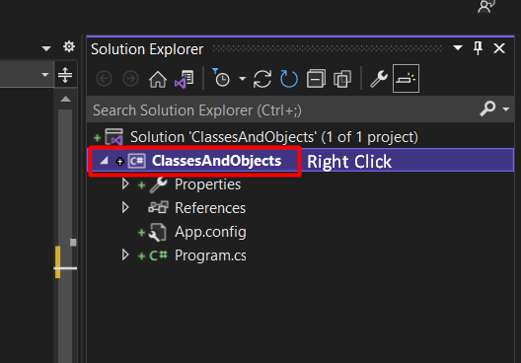
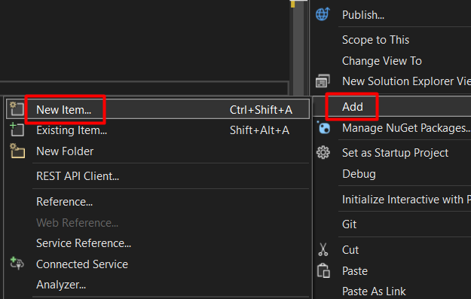
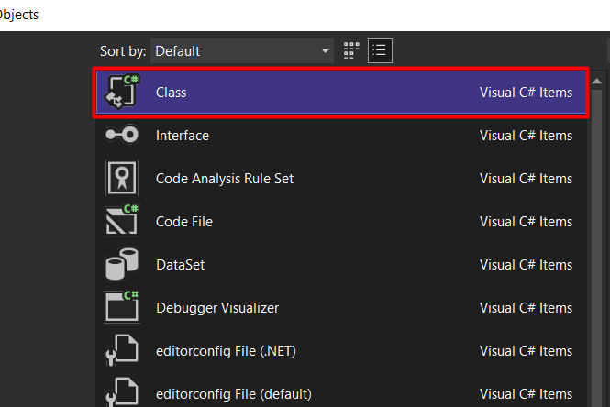
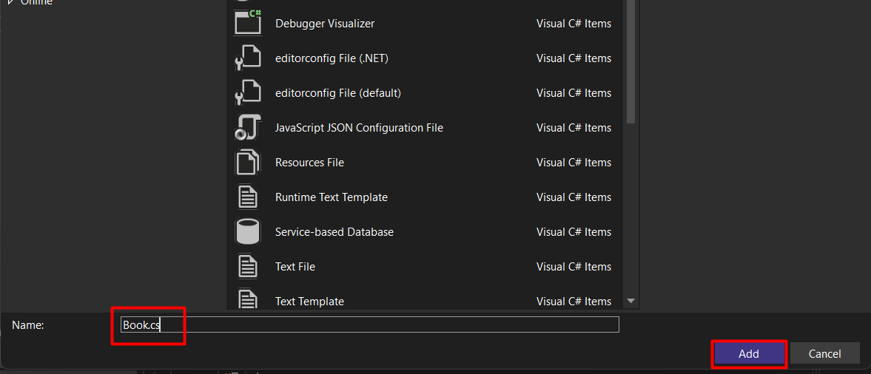
Classes and objects
Creating class file
3
2
4
1
5
6

Slide 65
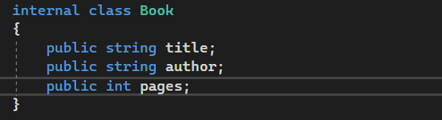
Classes and objects
Creating 3 fields – title, author, and pages in our Book class
Our fields are made public so they can be accessed from our program class

Slide 66
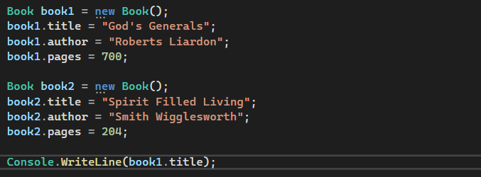
Classes and objects
Creating an object
Objects can use all the public fields and methods of a class.
Let’s create a Book object in our Main Method in the Program class

Slide 67
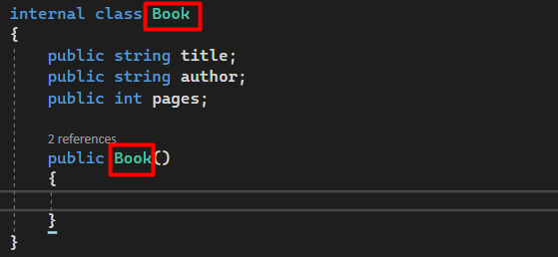
Classes and objects
CONSTRUCTORS
Constructor is a special method we can put inside a c# class (Book.cs) which is called whenever we create an object of that class
Any method that has the same name with the class in which it is created is called the constructor of that class as illustrated below:

Slide 68
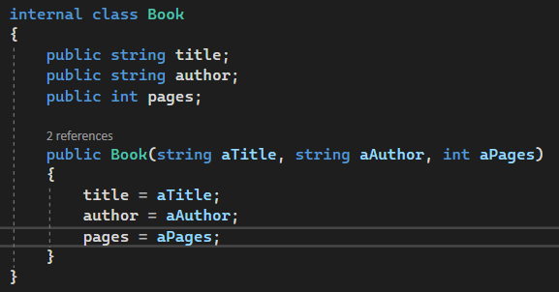
Classes and objects
CONSTRUCTORS
Now let us create a constructor in our Book class to accept parameters so as to simplify the code of our Book objects

Slide 69
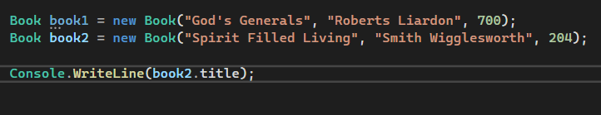
Classes and objects
CONSTRUCTORS
Let us create our Book objects and parse in the required parameters in our Program class

Slide 70
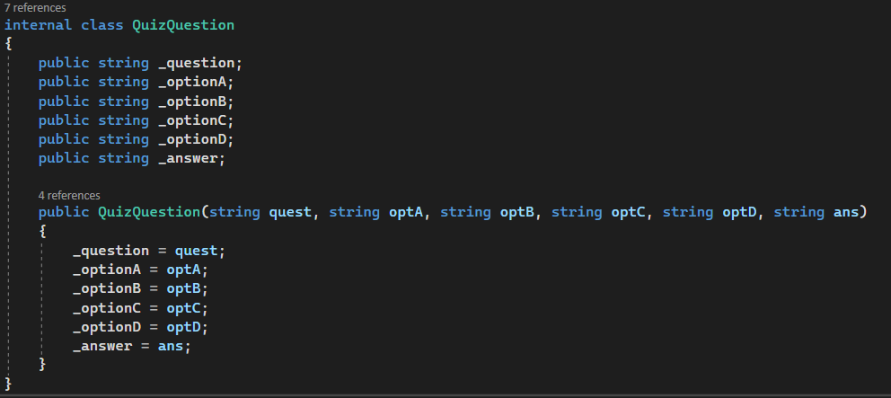
Classes and objects
EXAMPLE 2
Creating a QuizQuestion class and it’s constructor

Slide 71
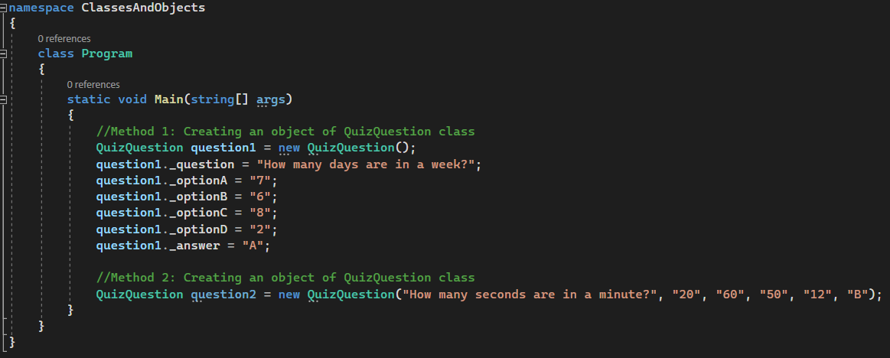
Classes and objects
EXAMPLE 2
Creating an object of our QuizQuestion class

Slide 72
Classes and objects - Lists of objects
QuizQuestion Class

Slide 73
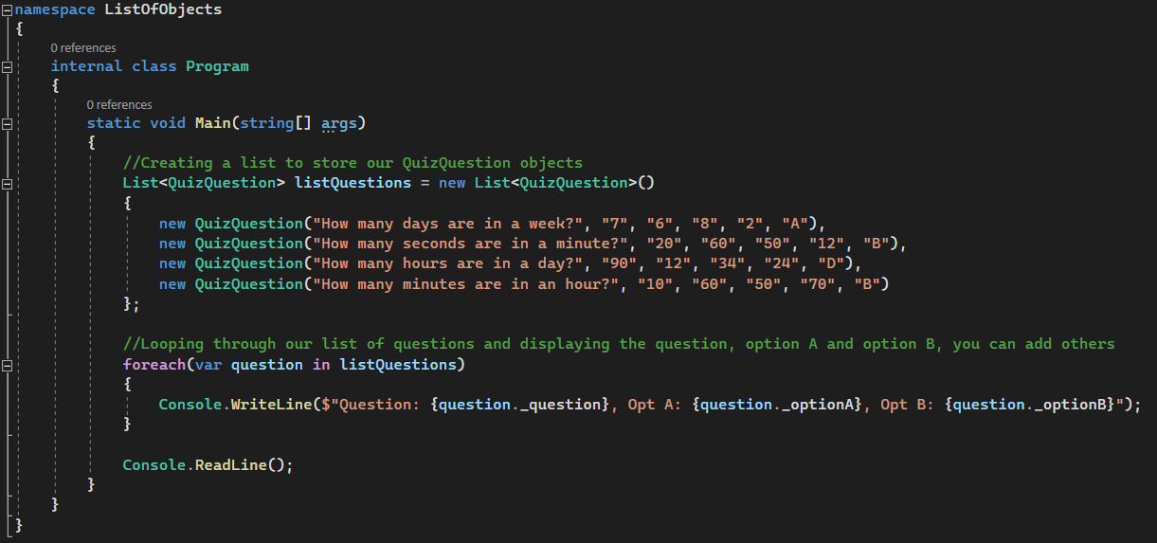
Classes and objects - Lists of objects
QuizQuestion Class

Slide 74
Fields and properties
Fields are normal variable members of a class. Properties are an abstraction to get and set their values.
Fields:
Fields are normal variable members of a class. Generally, you should declare your fields as private, then use Properties to get and set their values. By this way you won’t affect their values directly. This is common case practice since having public members violates the Encapsulation concept in OOP.
Properties:
They are actually special methods called “accessors”. Properties are called accessors because they offer a way to get and set a field if you have a private field. They have two codes inside; set{}; and get{}; called “property accessors”.
When you have a private field, you use Property to access that private field in order to get and set it’s value

Slide 75
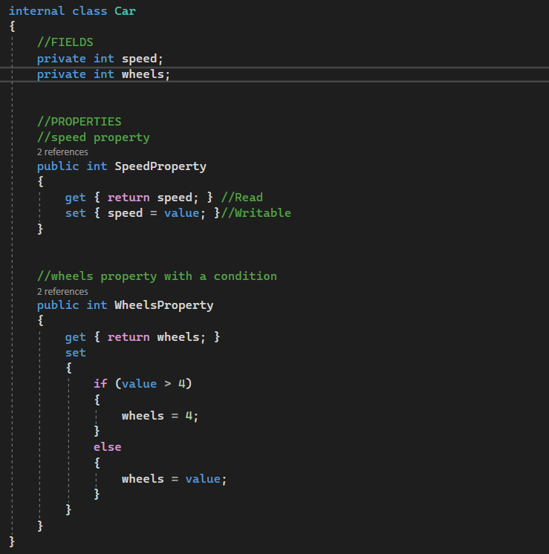
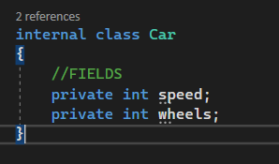
Fields and properties
Properties:
Fields:
“value” is a keyword, It refers to the assigned value, It’s like a parameter for the set method

Slide 76
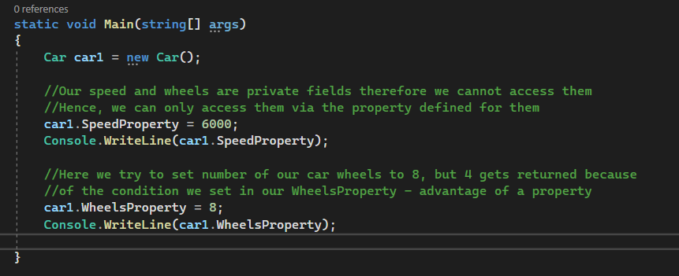
Fields and properties
Accessing our Properties from our Program class

Slide 77
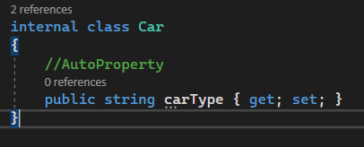
Fields and properties
AutoProperty
AutoProperty generates private field for us, and it is a shorthand for declaring a property when we only need to get and set it’s value without setting any condition

Slide 78
Project : Refactored Quiz App
Refactor your Quiz App to simplify it by making use of class and methods.
Note: Make use of auto property in your class and not fields.

Slide 79
Access modifiers
An Access modifier is a way to control access to a class and/or it’s members. We need access modifiers so as to create safety in our programs.
Types of c# access modifiers:
Public
Private
Protected
Internal
Protected Internal

Slide 80
Access modifiers
Public:
When class or members of that class are specified to be public, it means they can be accessed by other objects and methods anywhere within the application
Private:
When members of a class are specified to be private, it means they can only be accessed within that class in which they are defined and cannot be accessed outside that class except through properties.
Protected:
Protected classes or members of that class can only be accessed within the class in which they are defined and also inside the child classes. We will learn about this access modifier when we treat “Inheritance”.
Internal:
The internal access modifier is used to make variables and methods accessible within the assembly of the class in which they are defined
Protected Internal:
This access modifier is the combination of Protected and Internal modifiers. This means that this modifier makes a variable accessible to the child classes that are inside the same assembly of the class in which they were actually defined.

Slide 81
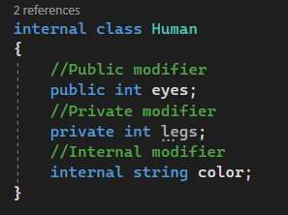
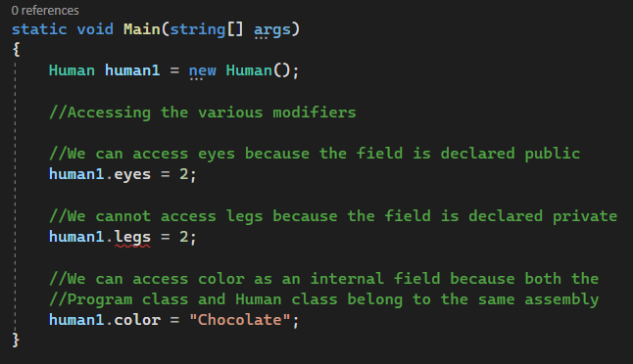
Access modifiers

Slide 82
Static modifier
The static modifier is used to declare a static member, one which belongs to the class itself rather than any one specific object.
Illustration:
We are starting a car race and we want to keep track of how many cars are instantiated that are entering the race. We can do that by creating a static field in our Car class to keep track of how many cars are created and instantiated.

Slide 83


Static modifier
Illustration with non-static field:
Car class
Program class

Slide 84


Static modifier
Illustration with static field:
Car class
Program class

Slide 85


Static modifier
Methods can also be static. Illustration:
Car class
Program class

Slide 86
Project : Word Guess Game
C# WORD GUESS GAMEINSTRUCTIONS
Unscramble/guess only a word from each scrambled word. Example: Scrambled word = elvo Unscrambled word = love
User can guess only up to 3 times after which he fails that particular guess and the correct answer is displayed and then moves to the next scrambled word. No point given for failure. If he passes the guess, give him a point then move to next scrambled word.
At the end of the guess game, the total points earned by the user should be displayed with all the scrambled words alongside their respective unscrambled words.
Your scrambled words should not be less than seven.
Make your code simplified and understandable as much as possible, following the SOLID principle with particular emphasis on 'O - Open for expansion but closed for modification’.
Each group should have their unique code base, that is, no copying from each other.
Every participant in each group will have a part to present therefore every group member must be involved in the project creation.
BEST OF LUCK

Slide 87
Inheritance
Inheritance is the programming concept that has to do with one or more child classes receiving fields, methods etc, from a common parent; kind of like how children inherit genes from their parents.
Parent class can have children classes, and anything that the parent class has, the child classes now has.

Slide 88

Inheritance
INHERITANCE EXAMPLE

Slide 89

Inheritance
Additional Info – abstract modifier
From our example, the abstract modifier prevents someone from creating an object from the Vehicle class hence the class is incomplete
If there is a class you do not want to instantiate objects from, you can preceed that class definitionwith the abstract keyword. You can also apply abstract keyword to fields, properties and methods

Slide 90
Class Work
Create a parent class of Animal and create 3 child classes of 3 different animals. Let each child class inherit from the parent class.
NB: The parent class should have a field/attribute that is common to all animals and the child classes should have attributes common to their species.

Slide 91
Handling exceptions
An exception is an error that occurs during execution.
Keywords in handling an exception:
try: try some code that is considered ‘dangerous’
catch: catches and handles exceptions when they occur
finally: always executes regardless if exception is caught or not

Slide 92
Handling exceptions
Illustration:
Assuming you try dividing a number with a string, your program would crash and you will get an exception. However we can handle this exception in such a way that our program does not crash, but rather we will get a friendly error prompt in our console indicating the type of error that occurred and the possible cause.
Lets look at a demonstration in the next slide

Slide 93

Handling exceptions
Illustration:
The parameter "FormatException" handles errors relating to formatting (text formatting)
The parameter "DivideByZeroException" handles errors when someone divides by zero
You can add a catch block that catches anything by using the parameter of "Exception"
The finally block is optional, it always execute regardless if an exception is caught or not
You can have more than one catch block

Slide 94
Debugging in Visual Studio
Debugging is an act of finding an error in lines of code
Refer to video for topic explanation.

Slide 95
Git & Github
Steps in linking a project with GitHub repository
Create an account or login to your GitHub account
Create a GitHub repository with the name of the project
Install GitBash software on your computer
Right click on the project folder to be linked with the repo and select “GitBash Here”, a command prompt window will open
Configure your username and email by running the following command
git config –-global user.name “enter your github username”
Git config --global user.email “enter the email address used for github”
Now lets proceed to link our project with our repository by running the following command step by step
git init
git add –A
git commit -m “Add a comment of your commit“
git remote add origin pasteLinkOfRepository
git push origin master
At this point, if you are using GitBash for the first time on your pc you will be required to sign in using your personal access token
Generate your personal access token by going into the settings of your GitHub account, then select Developer settings, then select Personal access tokens and click Generate new token
Enter a Note or description for the token being generated – you can just simply type Repo access
Select scopes by ticking the checkbox of “Repo” then scroll down and click Generate token
Copy the access token and paste it somewhere for future use, and head back and paste the access token in the GitHub Sign up window

Slide 96
Git & Github
Steps in linking a project with GitHub repository
19. At this point your project would be pushed to the github repository you created
20. When changes are made to your project you can update your github repository with those changes directly from your visual studio (under Git Changes tab) or via gitbash

Slide 97
Interfaces
An interface is a completely "abstract class", which can only contain abstract methods and properties (with empty bodies):
It is considered good practice to start with the letter "I" at the beginning of an interface, as it makes it easier for yourself and others to remember that it is an interface and not a class.
By default, members of an interface are abstract and public.
Note: Interfaces can contain properties and methods, but not fields.

Slide 98

Interfaces
Example

Slide 99

Interfaces
Notes

Slide 100

Interfaces
Example 2 – Multiple Interfaces

Slide 101
Class Work
Create an interface of Vehicle and create at least two classes that implements the Vehicle interface.
Your interface should have a method that your classes can adopt.
Create an object of your classes and call the method.

Slide 102
Project : Library App
C# LIBRARY APP
(LIBRARY BOOK BORROWING & FINE CALCULATION)
INSTRUCTIONS:
Have two options to either borrow a book or return a book borrowed.
If the option of borrow a book is chosen, then the following should happen:
1. Have lists of books available for borrowing in the library.
Note: Display the list of all books.
2. Once a book has been borrowed it should be taken out of the library and you cannot borrow that particular book anymore.
Note: After each book is borrowed out, display the list of the remaining available books in the library
3. Once the library is empty, you should not be able to borrow, it should display library empty.
If the option of return book is chosen, then the following should happen:
1. If the book is returned on or before 5 days, no fine will be charged.
2. If the book is returned after the expected return day (between 5 and 10 days), fine would be N50 per day defaulted.
For example: If you return the book on the 15th day you will be charged a fine of N50 on the 5 days defaulted, that will be 5 multiply by N50.
3. If the book is not returned after 30 days, fine would amount to N100 per day defaulted.
For example: If you return the book after 30 days upwards, you will be charged a fine of N100 on all the days defaulted starting from day 11.
BEST OF LUCK

Slide 103
Linq
Language-Integrated Query (LINQ) is a powerful set of technologies based on the integration of query capabilities directly into the C# language.
Refer to video for explanation and illustration.

Slide 104
LinqTest

Slide 105
Unit Test
In the software development process Unit Tests basically test individual parts ( also called as Unit ) of code (mostly methods) and make it work as expected by programmer. A Unit Test is a code written by any programmer which test small pieces of functionality of big programs.
Refer to video for explanation and illustration.
Additional resource: https://docs.microsoft.com/en-us/visualstudio/test/walkthrough-creating-and-running-unit-tests-for-managed-code?view=vs-2022

Slide 106
Class Work
C# SIM CARD APP FOR UNIT TESTING
1. Method to recharge
You cannot recharge above 10k
2. Method to buy data
You cannot buy data more than the amount you have in your account
3. Method to borrow airtime
If account balance is not empty you cannot borrow
4. Method to transfer airtime to friend
You cannot transfer above what you have in your account
5. Method to check if airtime balance is below 20naira
Create a unit test for all the methods and ensure they are all working.
BEST OF LUCK

Slide 107
Working with files
Refer to video for explanation and illustration.

Slide 108
Working with filesTest

Slide 109
Project : File Mover App
Write a program to move all images in your Downloads folder to an Images subfolder within the Downloads folder.
Hint: To get the full path of your Downloads folder go to Local Disk, Users, Students, Downloads. Copy the path from the path tab above.
REQUIRED:
1. Upon running your app, Images subfolder should be automatically created if it does not exist.
2. If no image file exists in the Downloads folder, prompt the user with associated message.
3. If an image in the Downloads folder has same name with an image in the Images folder an exception error is thrown thereby causing the app to crash. Handle this exception with the appropriate block to prevent the app from crashing when such condition of similarity in name is present.
BEST OF LUCK!!

Slide 110
Project : Refactored Phone Book App
Refactor your Phone Book Application to make use to methods – the logic of adding, viewing, updating and deleting should be in a method in a different class and then called in the program class.
Create a functionality to store your contact info in a text file rather than a dictionary.

Slide 111

Complex Classes
Characteristics of a complex class is a class that has a property of a Class, List, Dictionary, Collection etc.

Slide 112
Project : Airline Reservation System
AIRLINE RESERVATION SYSTEM PROJECT
Create an app that does the following
1. Have an object list of Planes
2. Register a passengers
3. Add a flight
4. Add a passenger to a flight
5. View a flight detail and display list of all passengers on that flight
CLASSES TO HAVE:
- Plane (Name, Aircraft No., No of seats)
- Passenger (First Name, Surname, Passport No.)
- Flight (Flight No., Takeoff, Destination, Date of flight, List of passengers, Plane)

Slide 113
Sharing data between classes
Refer to code for illustration.

Slide 114
Project : Search Engine
…

Slide 115
Entity Framework
Refer to video for explanation and illustration.

Slide 116
Project : Bank App
…

